Slide 1
MyMasjid Flutter Architecture

Slide 2
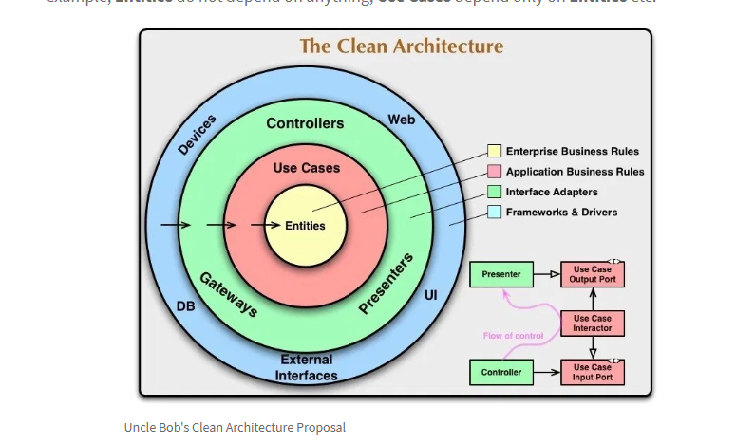
Clean Architecture

Slide 3
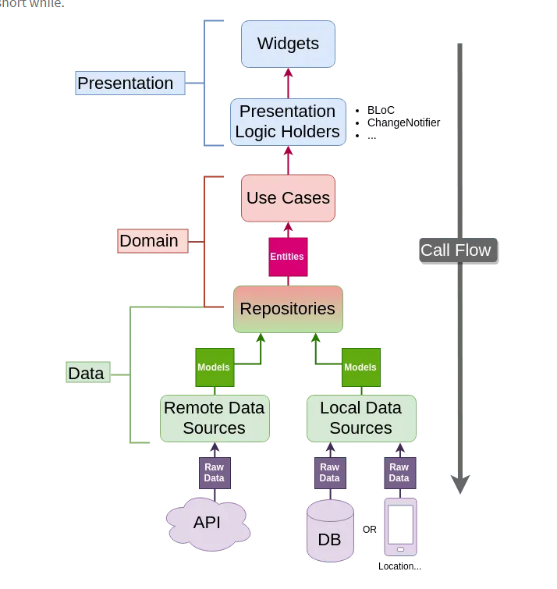
Proposed MyMasjid Flutter Structure

